Slide 1
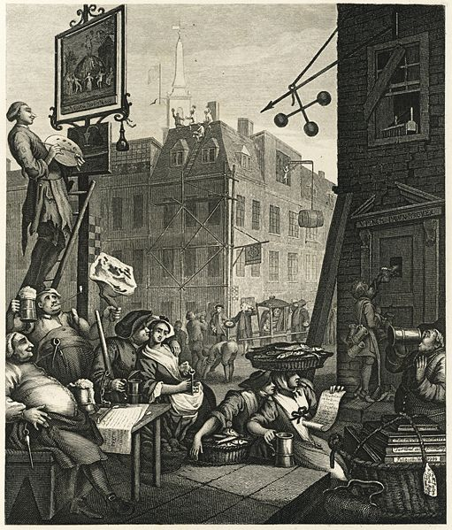
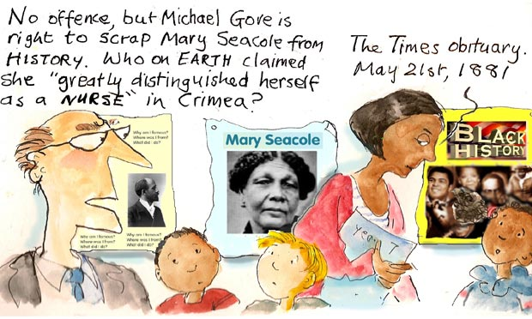
Starter: Remind yourself of London and Checking out me History

Slide 2

Assessment Objectives
AO1: Read, understand and respond to texts. Students should be able to: maintain a critical style and develop an informed person response; use textual references, including quotations, to support and illustrate interpretations.
AO2: Analyse the language, form and structure used by a writer to create meanings and effects, using relevant subject terminology where appropriate.
AO3: Show understanding of the relationships between texts and the contexts in which they were written.
AO4: Use a range of vocabulary and sentence structures for clarity, purpose and effect, with accurate spelling and punctuation.
Notes:
Resource 1. Additional help for this task can be found on p. 6 & 7 in the poetry student book.

Slide 3
Date:
Power & conflict
Title: Checking out me history
Poet: John Agard
Main Ideas/ Theme:
The power to influence/ suppress history
The power to change history
Language:
Dialect features (Caribbean creole)
Repetition (“but”)
Anaphora
Free verse
Quatrains
Metaphor
Imagery:
Used about the west-African and Jamaican figures in the poem to make them seem more alive
Context: Agard is trying to understand his own identity and how that lines up with what he was taught in school
Tone: Protest/ anger but moving onto a more optimistic tone
Rhythm/ Rhyme:

Slide 4
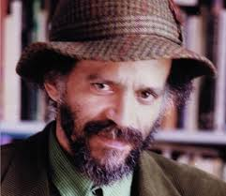
John Agard
Born in Guyana (which was a British Colony at the time).
Moved to London in 1977
Has worked as a teacher, a librarian and a journalist
Has been writer in residence at several organisations

Slide 5
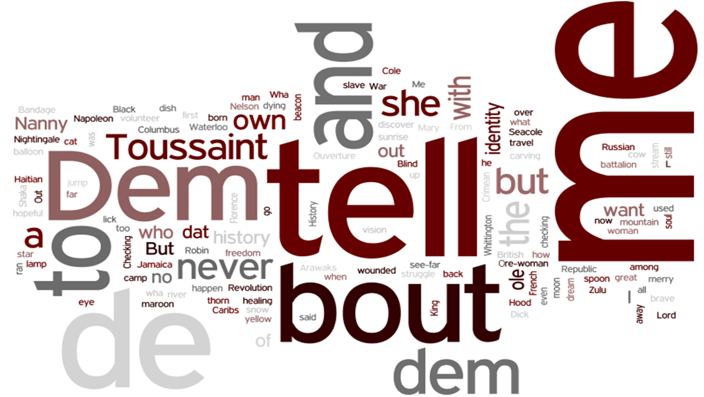

Slide 6
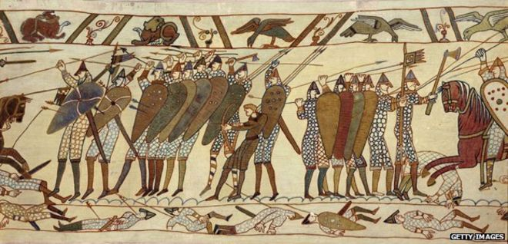
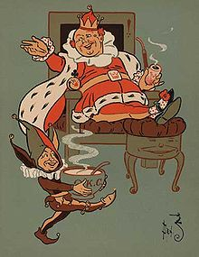

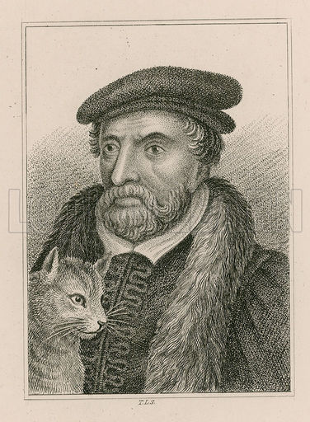
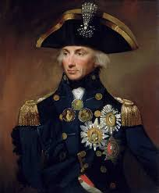

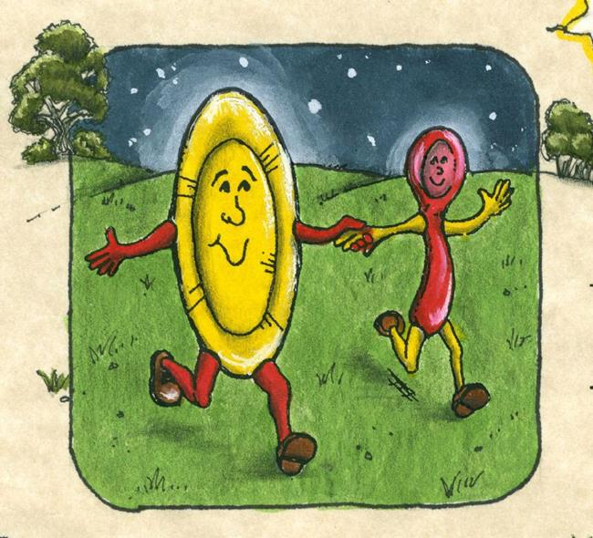
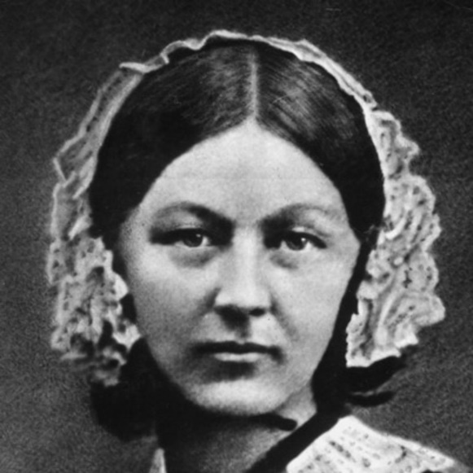


Slide 7
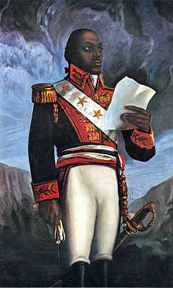
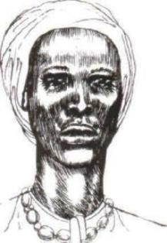
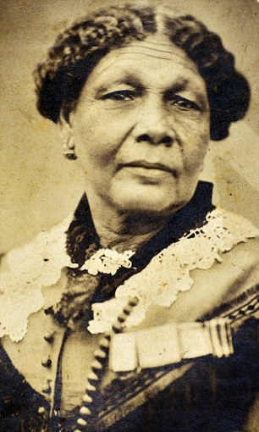
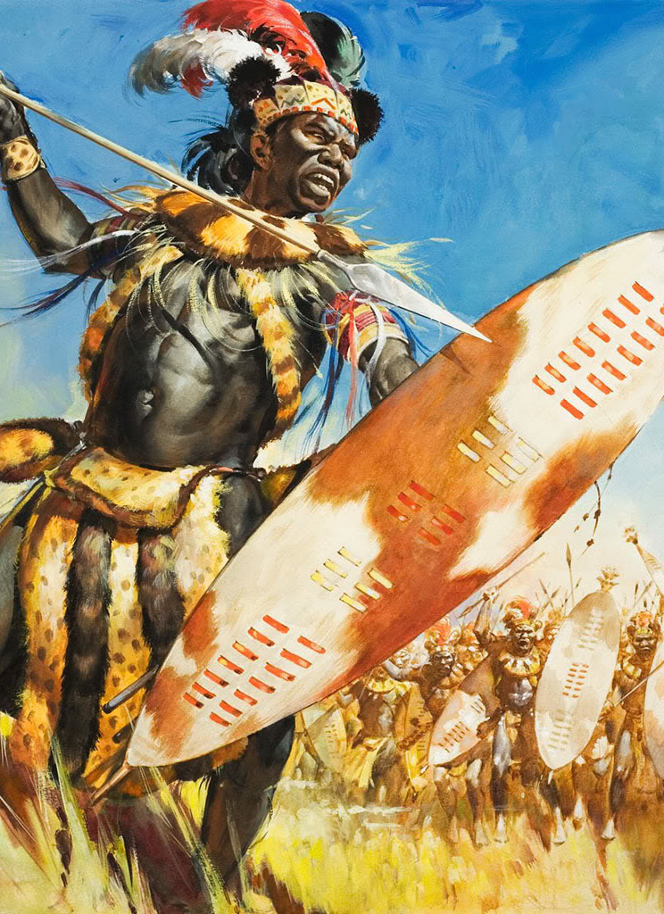

Slide 8
Date: 1794
Power & conflict
Title: London
Poet: William Blake
Main Idea/ Theme: The misery caused by those in power
Language:
Anaphora
Alliteration
Synecdoche
Repetition
Dual meanings
Hyperbole
Metaphor
Oxymoron
Imagery:
Restrictions everywhere, even in the minds of people and the streets themselves
Context:
Blake was a Romantic poet who believed in social change and the corrupt power of the rich in Britain. This is based on a walk through London one evening.
Tone: Critical
Rhythm/ Rhyme:
ABAB, quatrains

Slide 9
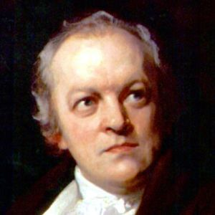
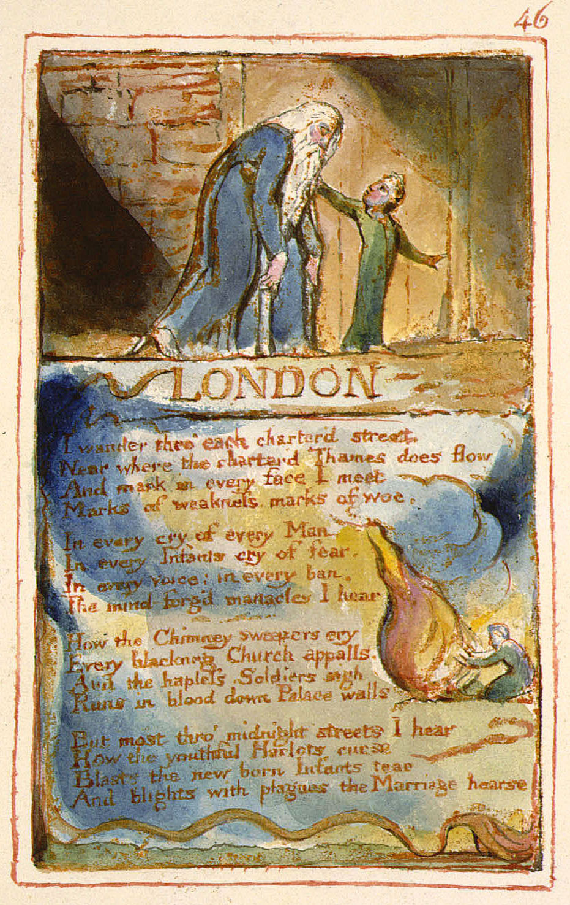
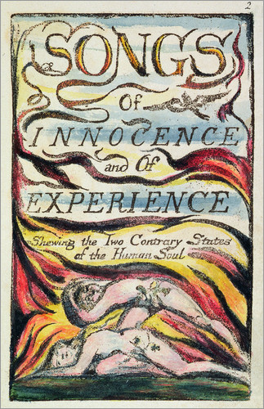
William Blake
Blake lived in London for most of his life– so was well placed to comment on what was happening there in the 18th century.
Blake lost faith in religion – this was due to the Church refusing to help the children that suffered – a frequent theme in his poetry! Have a look for this theme in London.

Slide 10
Show some understanding of implicit ideas, perspectives and contextual factors.
(Level 2-3- 3/4)
Thoughtfully consider ideas, perspectives and contextual factors by examining links.
(Level 4-5- 5-7)
Explore convincing links between ideas, perspectives and contextual factors. (Level 6- 8/9)
1757
1780
1789
1793
1794
1798
1827
The French Revolution
Irish Rebellion
Britain declares war on France
Blake is involved in the Gordon riot.
London is published as part of Songs of Innocence and Experience
Bear in mind that this poem is in the Conflict and Power section of the anthology. Where is there conflict? Consider the social context (industrial revolution) and these events.
A03: Text – context relationship

Slide 11
Comparing the poems
Feature/ technique | Checking out me history John Agard | London William Blake
Restriction of ideas/ misuse of power | “Bandage up me eye with me own history/ Blind me to me own identify” People in power restricting those under their influence through ideas | “Mind-forged manacles” People have been taught they should not expect better and no longer believe that they do
Other poems | Tissue, The Emigree

